Slide 1
SECURITY BUDDY
Group 3
Name | ID
Shafin T. Mashfu | 1620255042
Rubayet Zaman | 1620684642

Slide 2



COMPONENTS
Computer
Camera
Microcontroller

Slide 3
People Counting
In order to count an object in a video stream, we need an easy way to store information regarding the object itself, including:
It’s object ID
Whether or not the object has already been counted

Slide 4
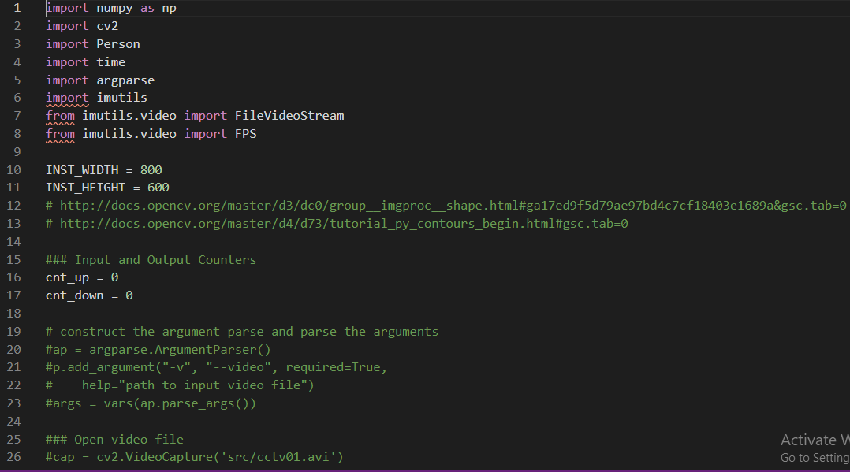
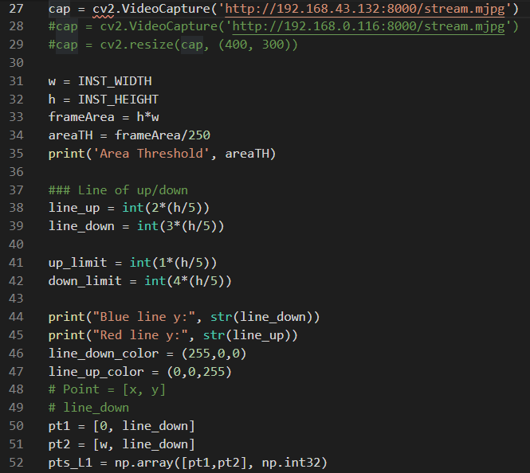
People Counting Code:

Slide 5
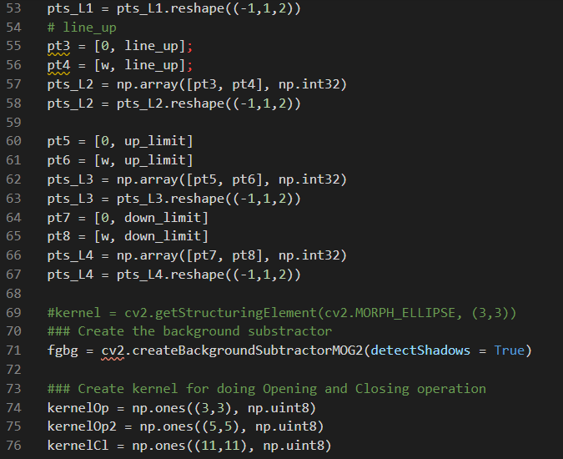
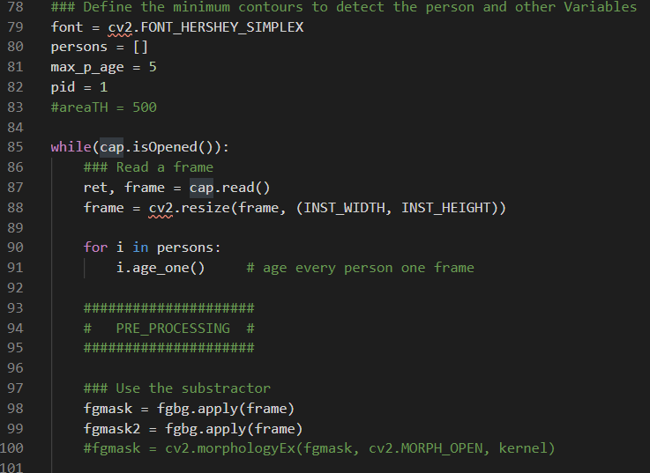
PEOPLE COUNTING CODE

Slide 6
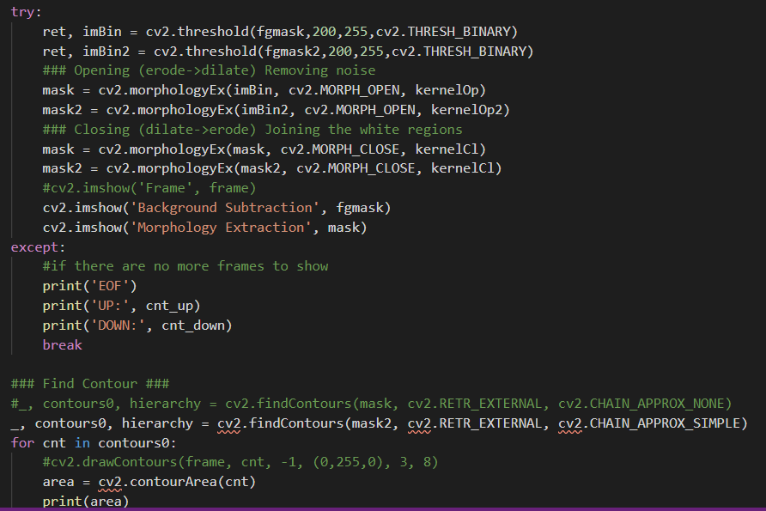
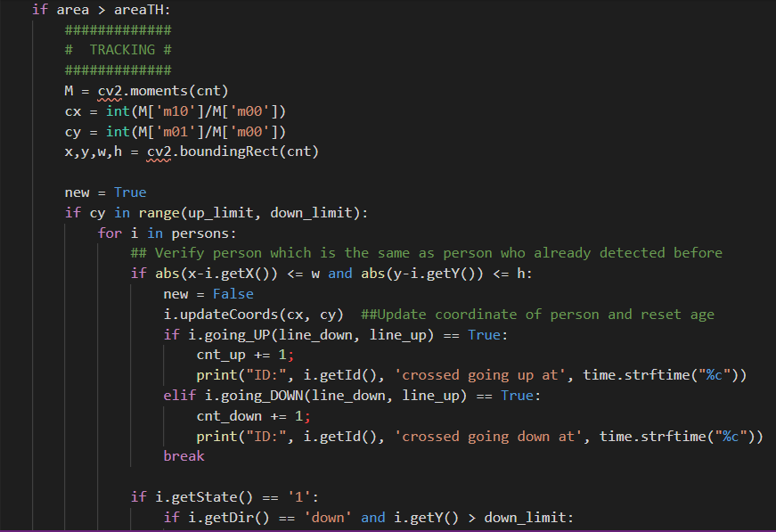
People Counting Code:

Slide 7
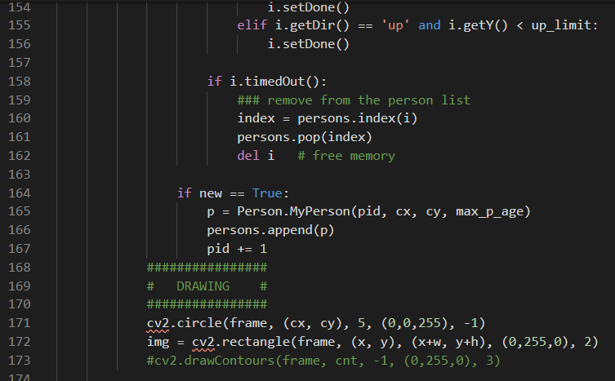
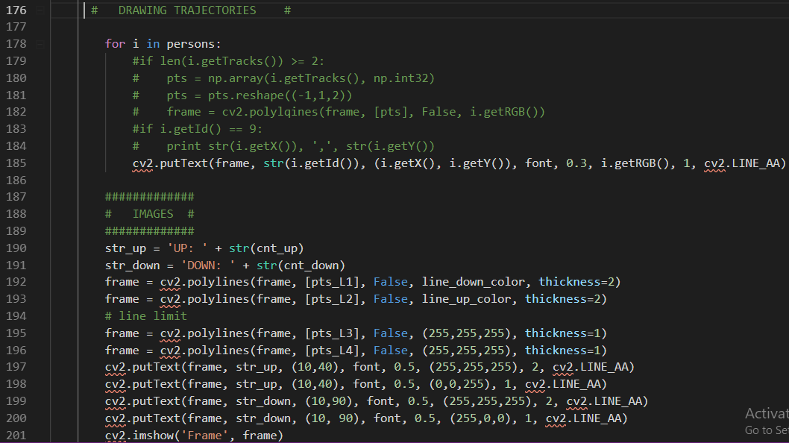
People Counting Code:

Slide 8
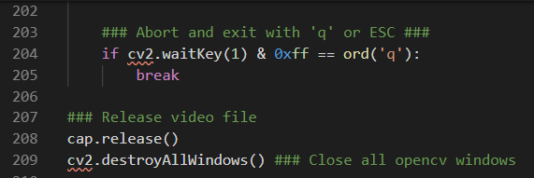
People Counting Code:

Slide 9
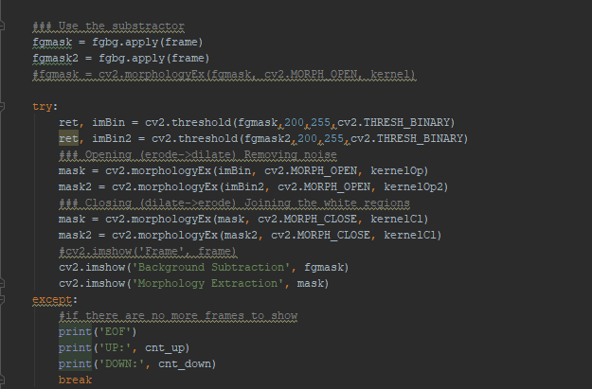

People Counting Code:
To keep a count
Printing the total number of people

Slide 10
Implementing Notification Code:
Next Week Task:
Adding SMTP library
Adding sender’s mail ID
Adding Receiver's mail ID

Slide 11
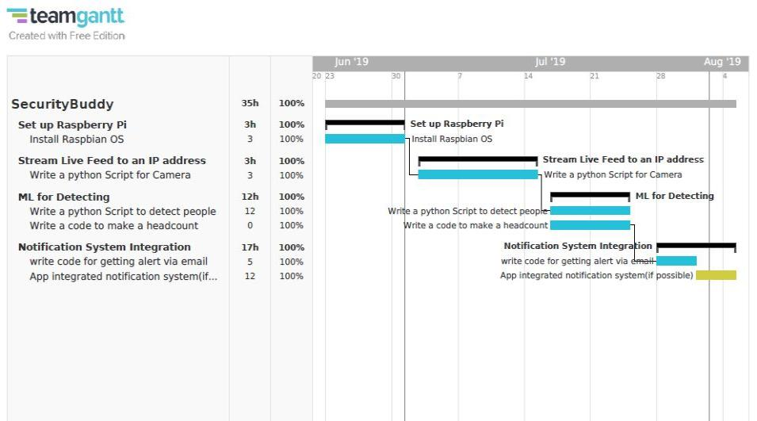
GANTT CHART

Slide 12
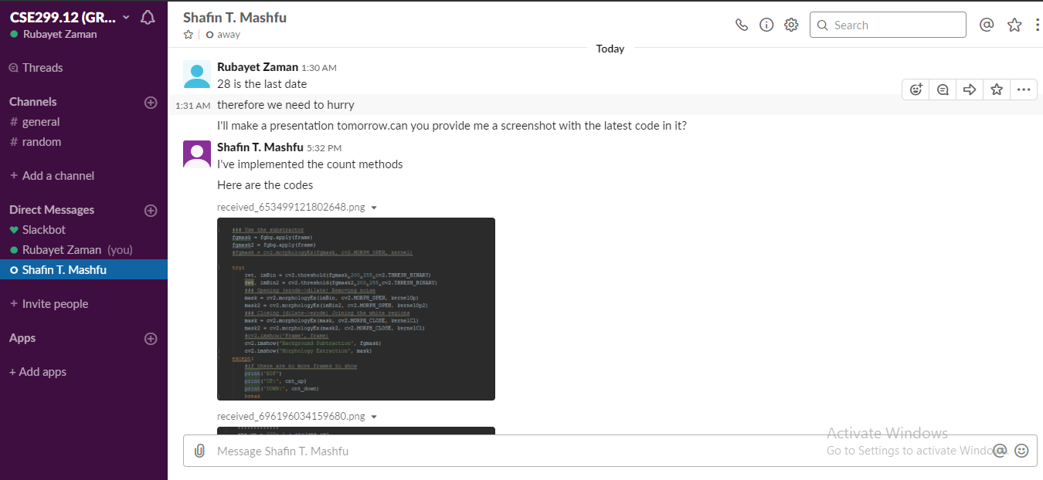
Slack Update

Slide 13
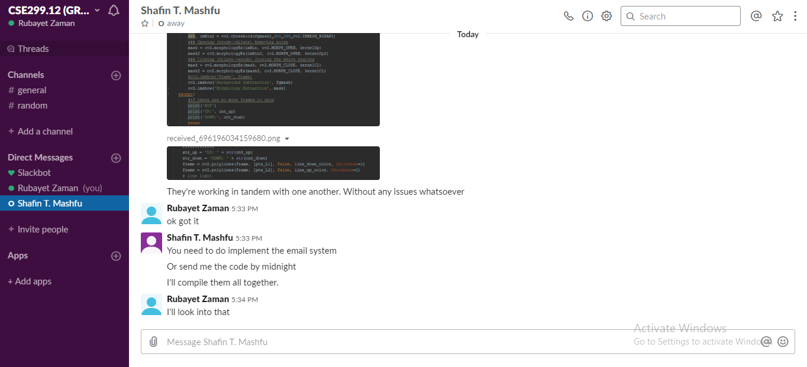
Slack Update

Slide 14
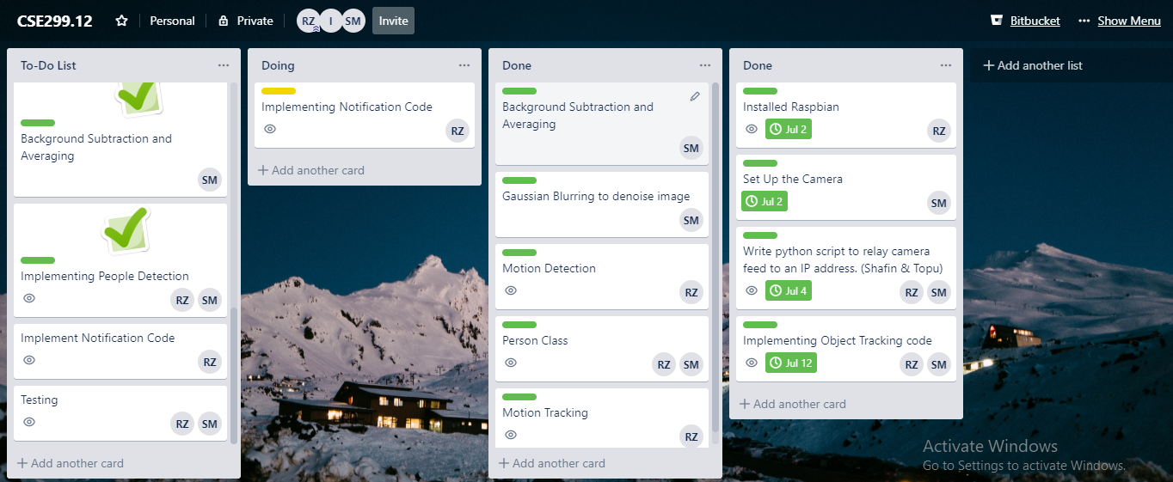
Trello Update

